Slide 1
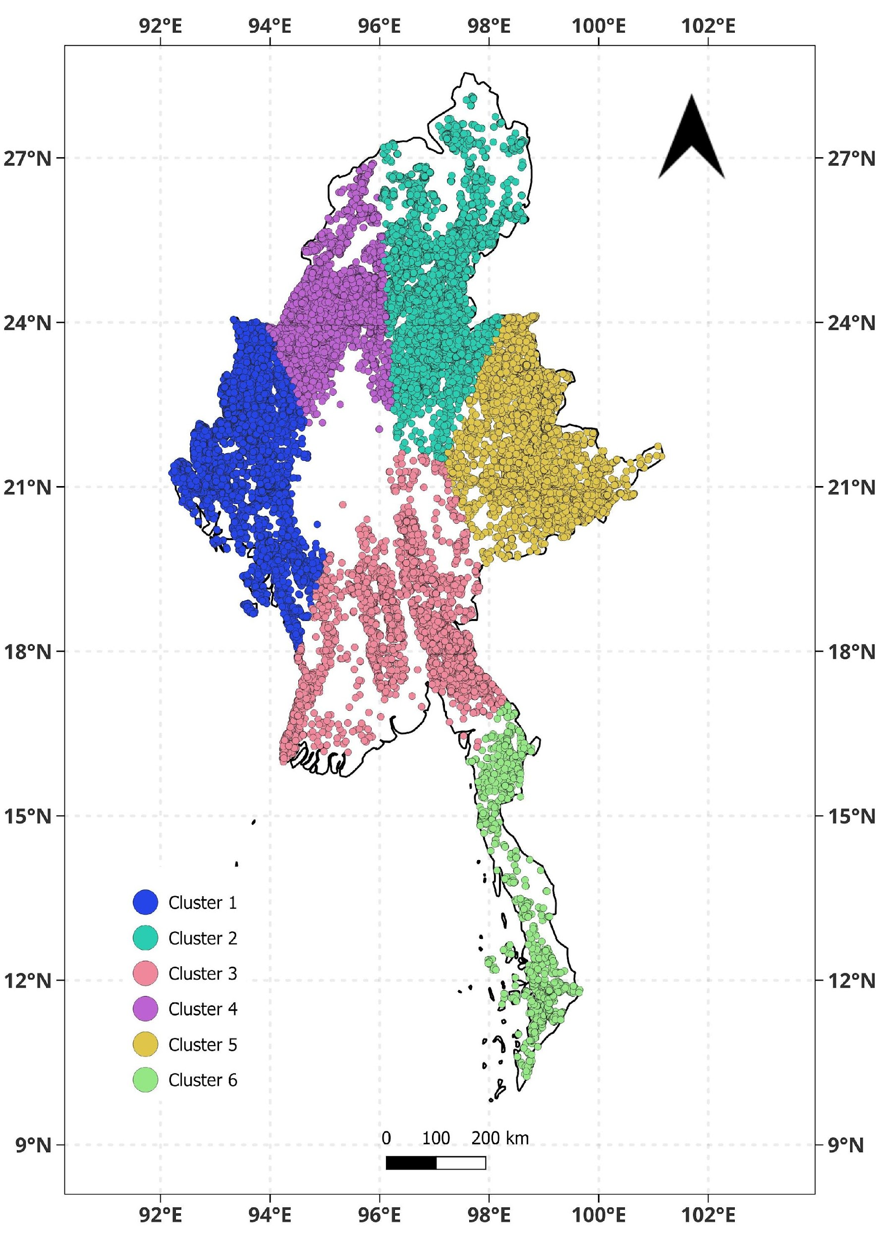
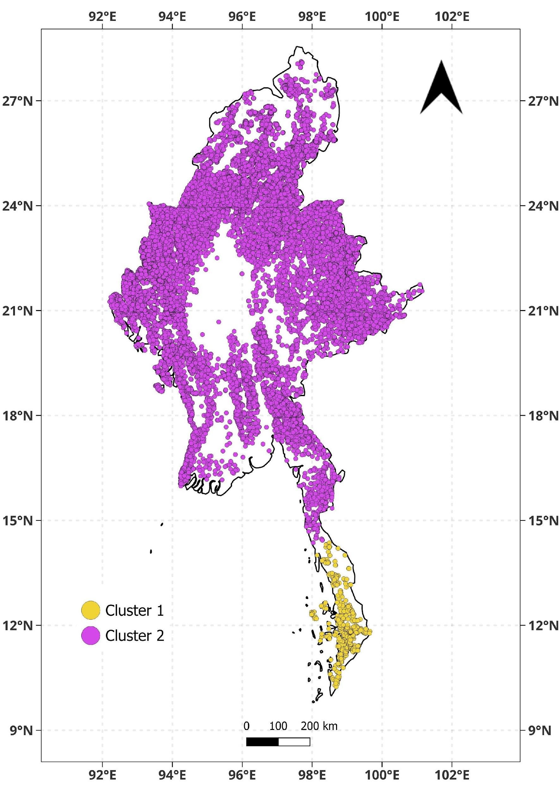
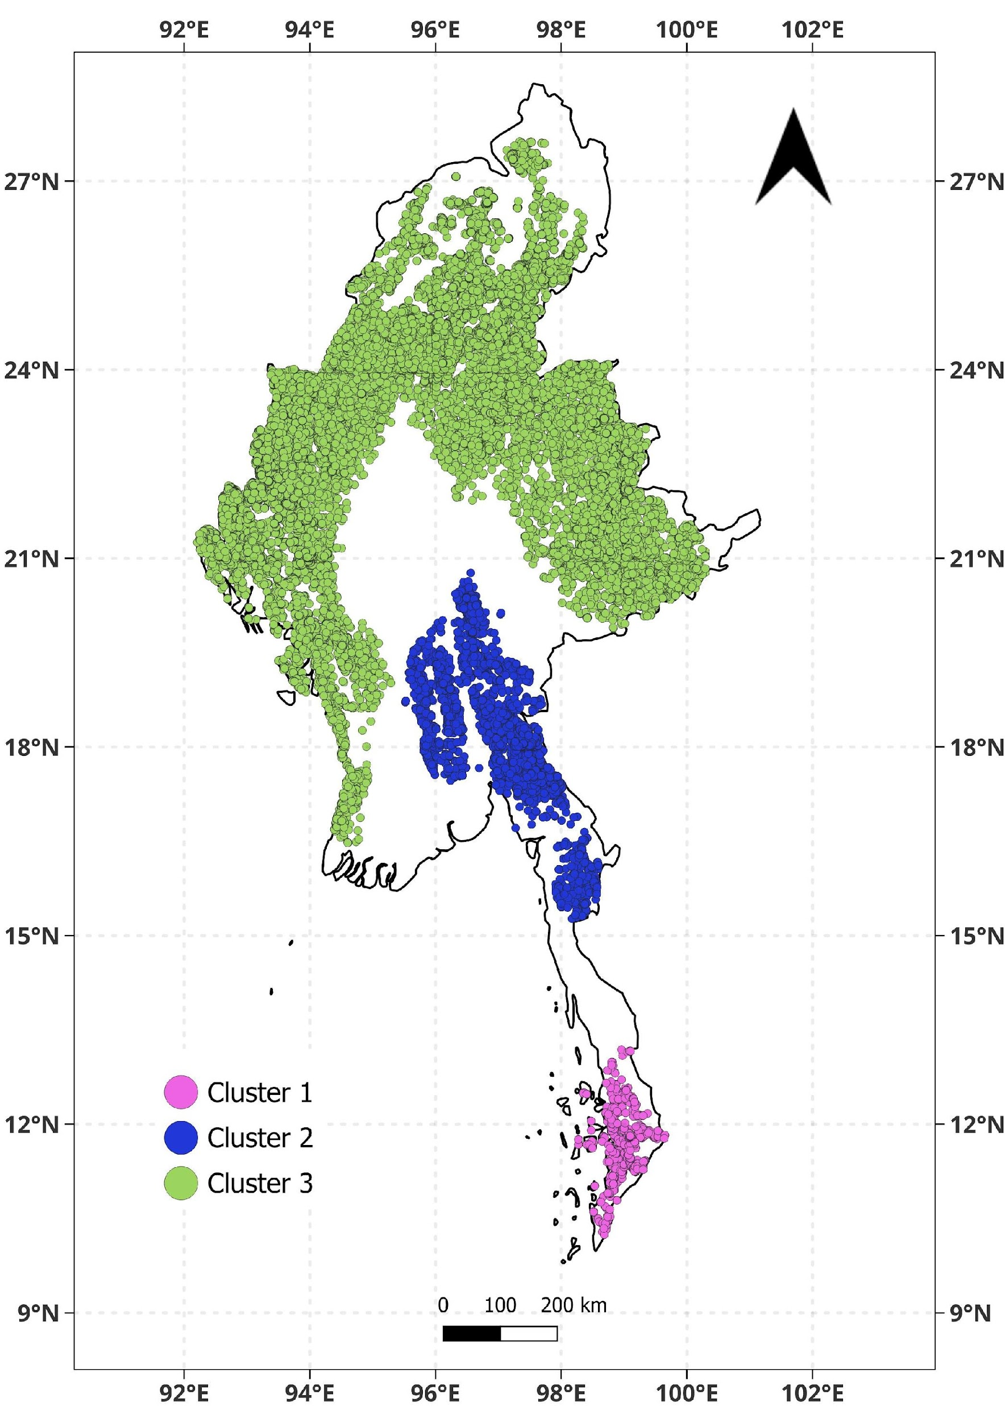
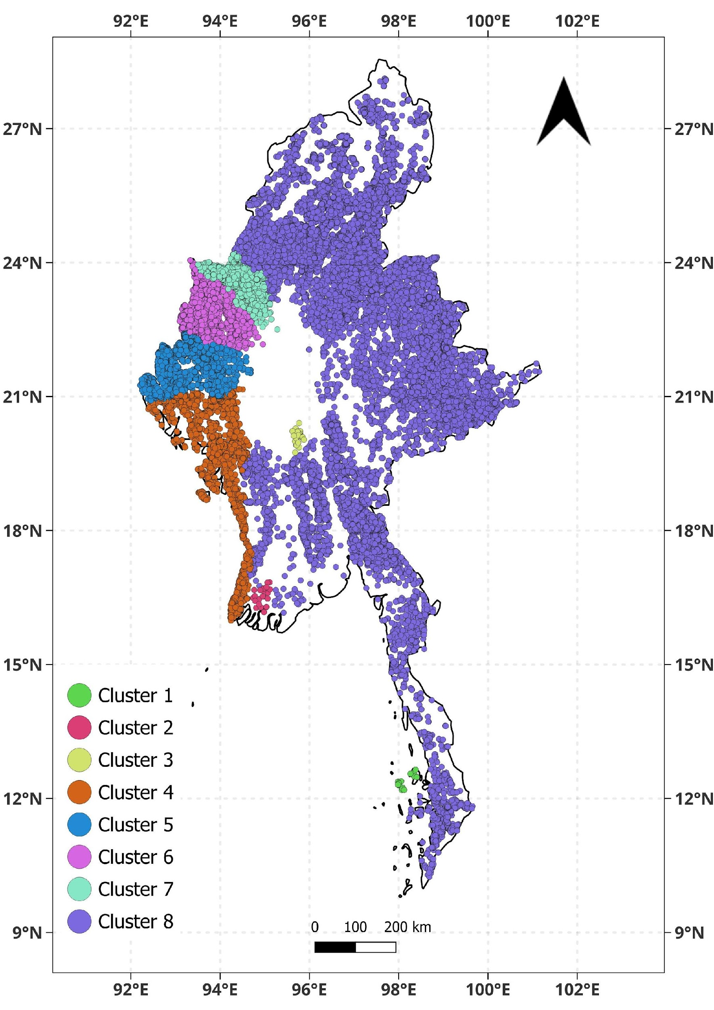
Forest Fires
KMEANS
DBSCAN
HDBSCAN
HiSpatial

Slide 2
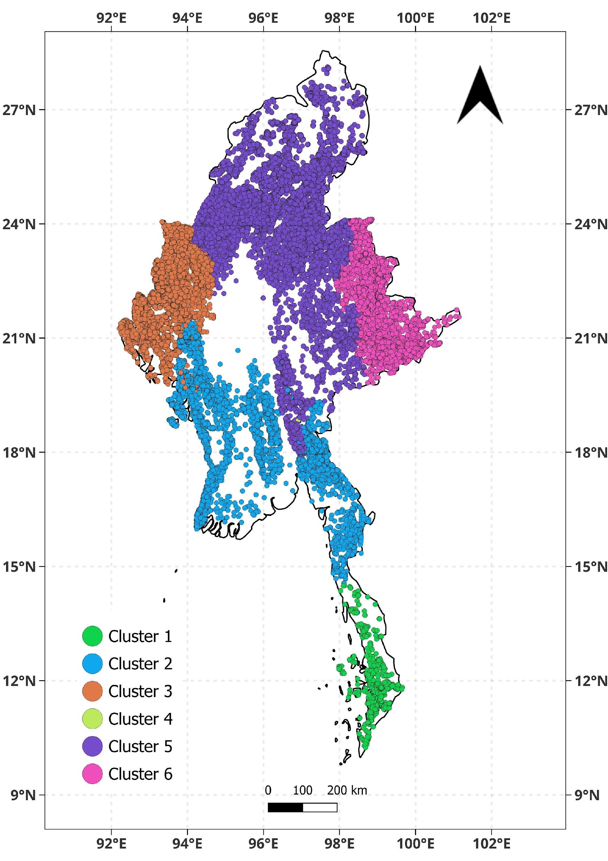
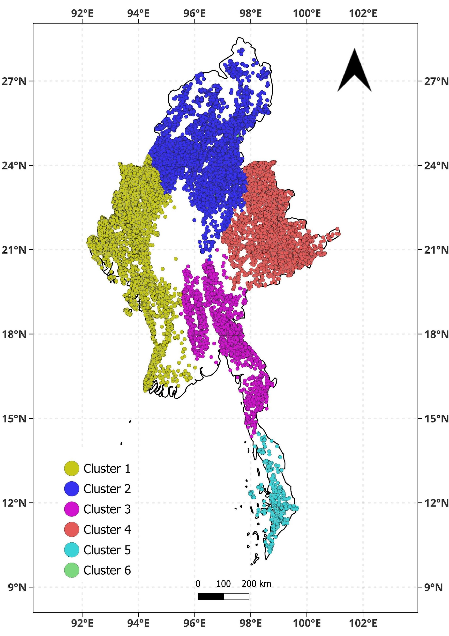
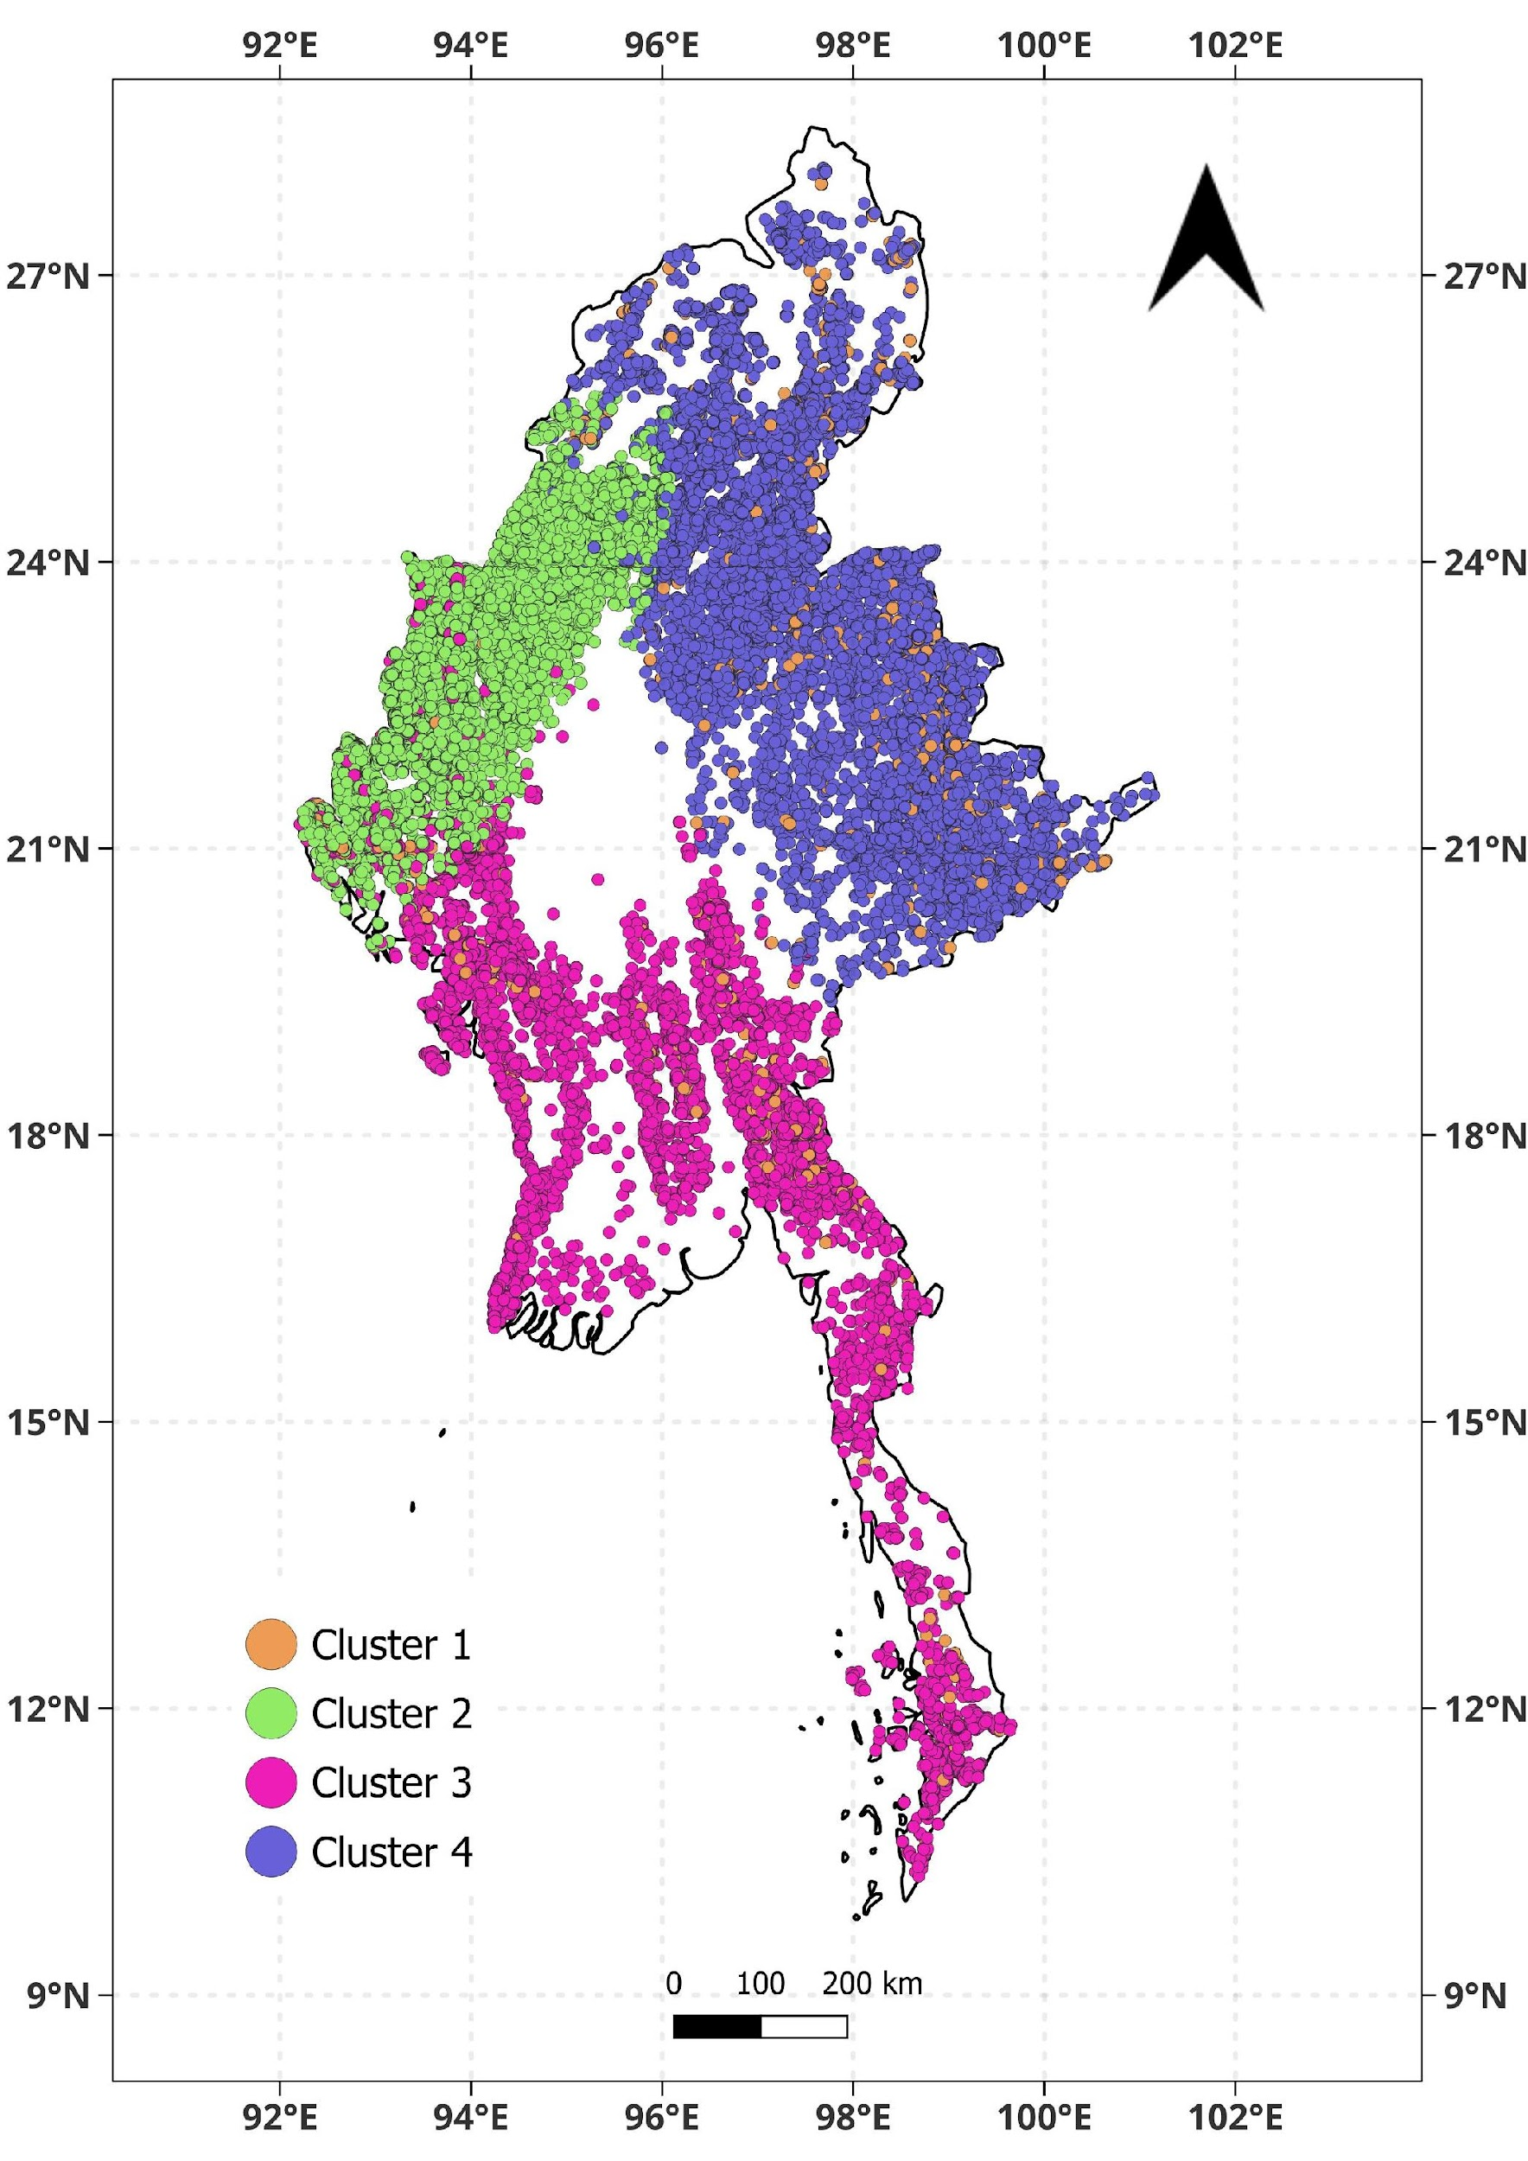
Forest Fires
HIERARCHIAL
BIRCH
GMM
(Gaussian Mixture Model)

Slide 3
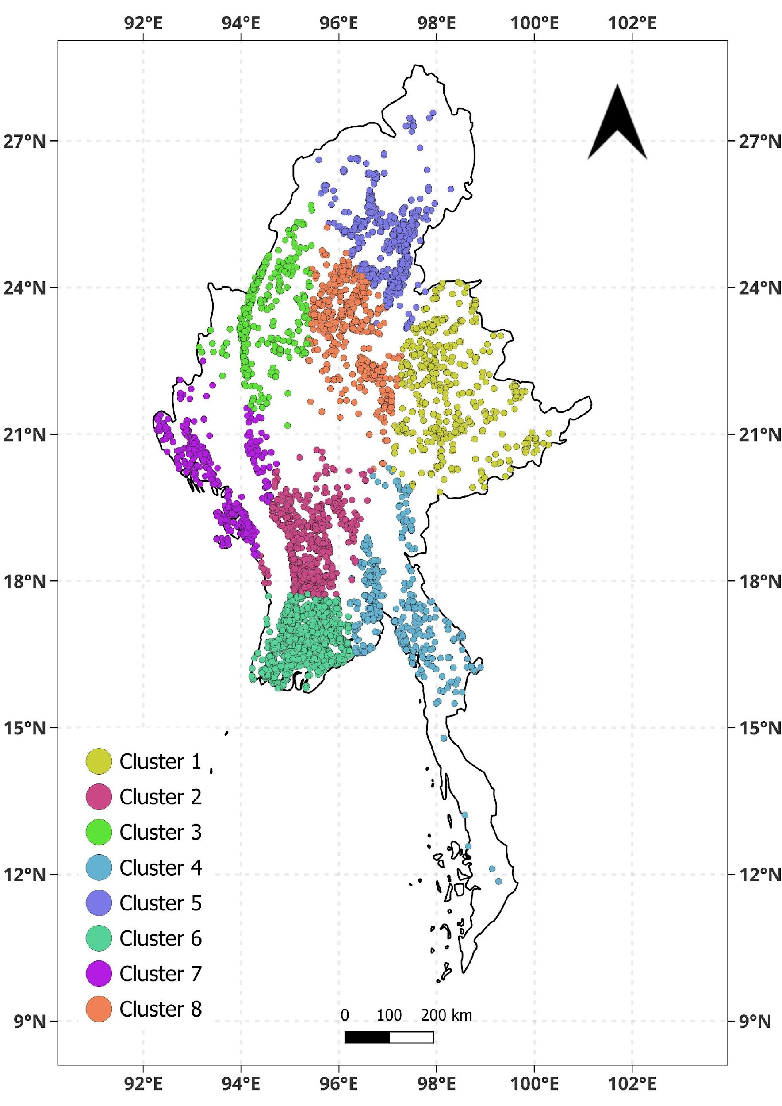
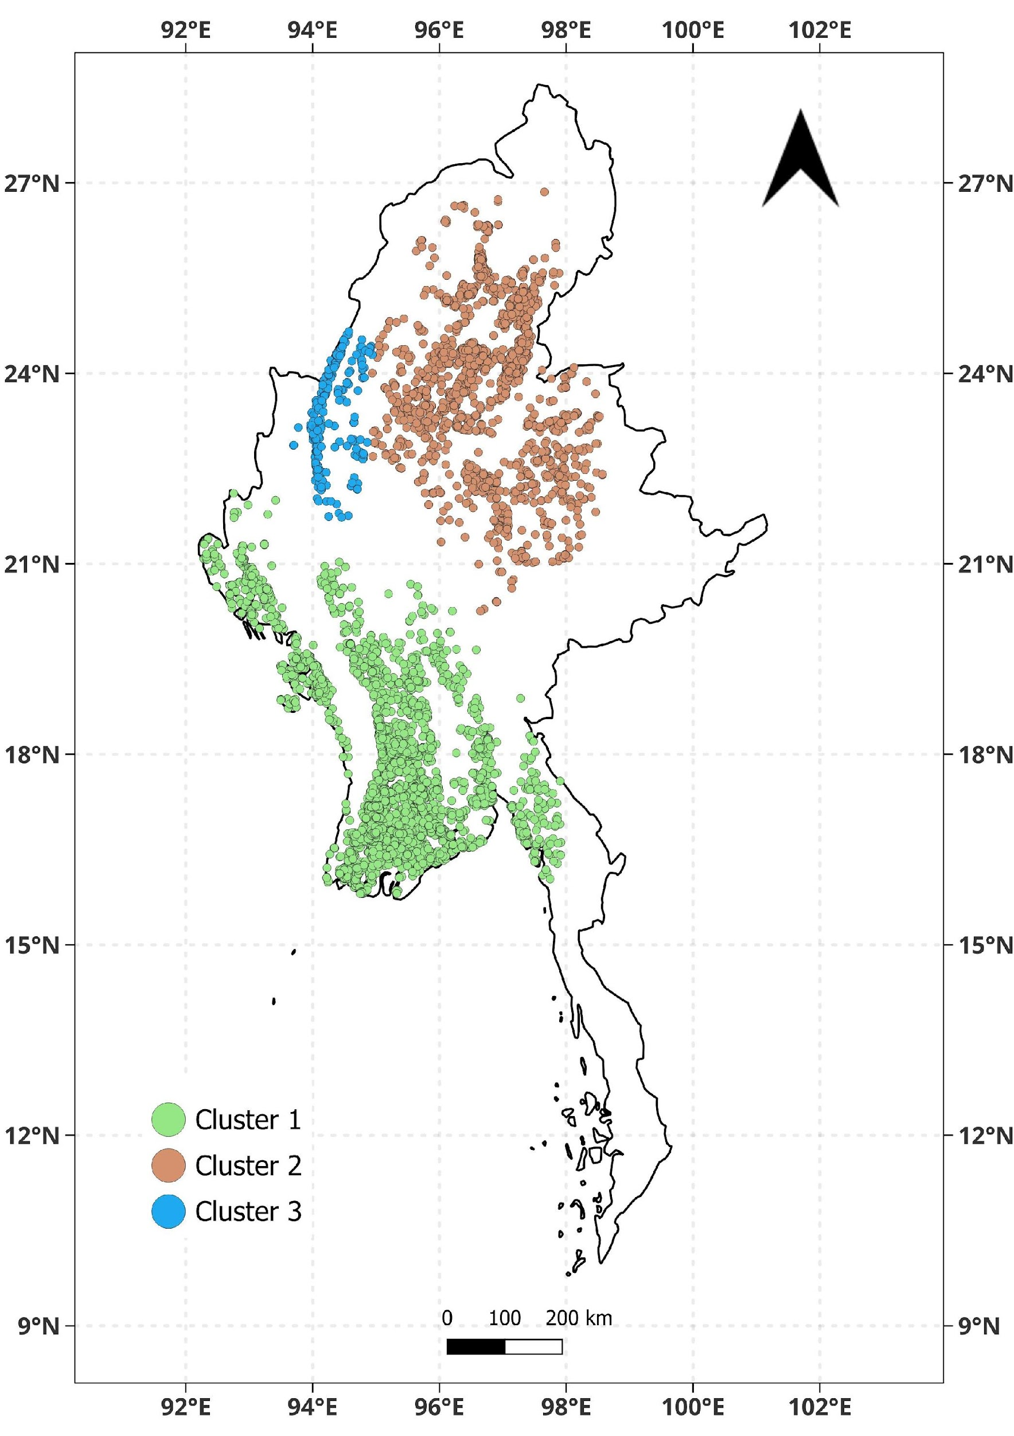
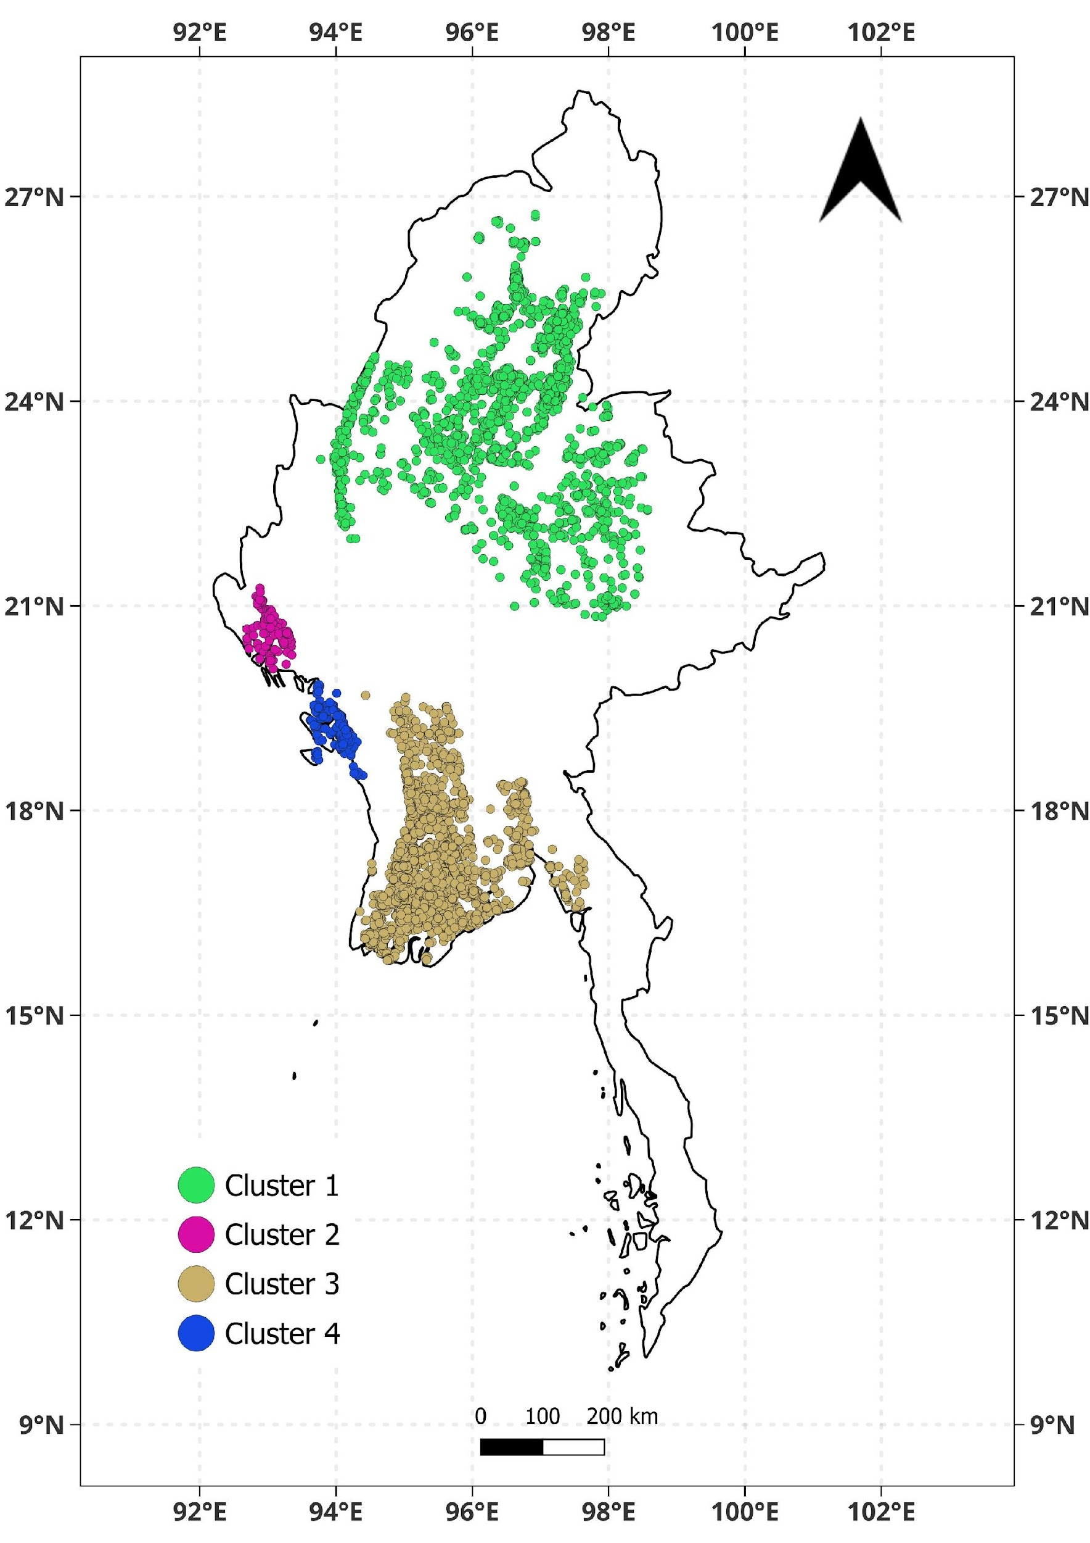
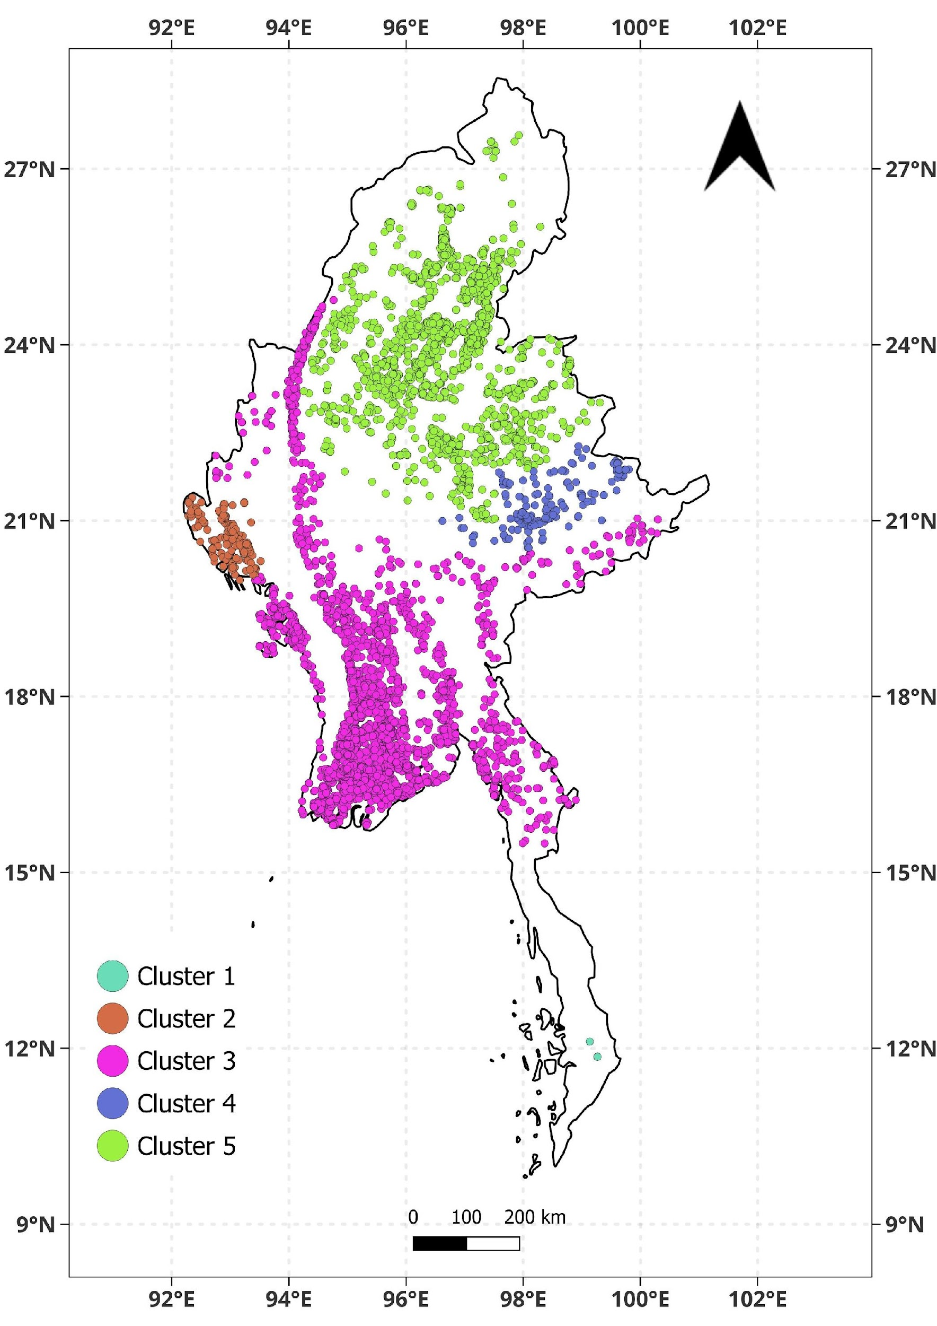
Agricultural Fires
KMEANS
DBSCAN
HDBSCAN
HiSpatial

Slide 4
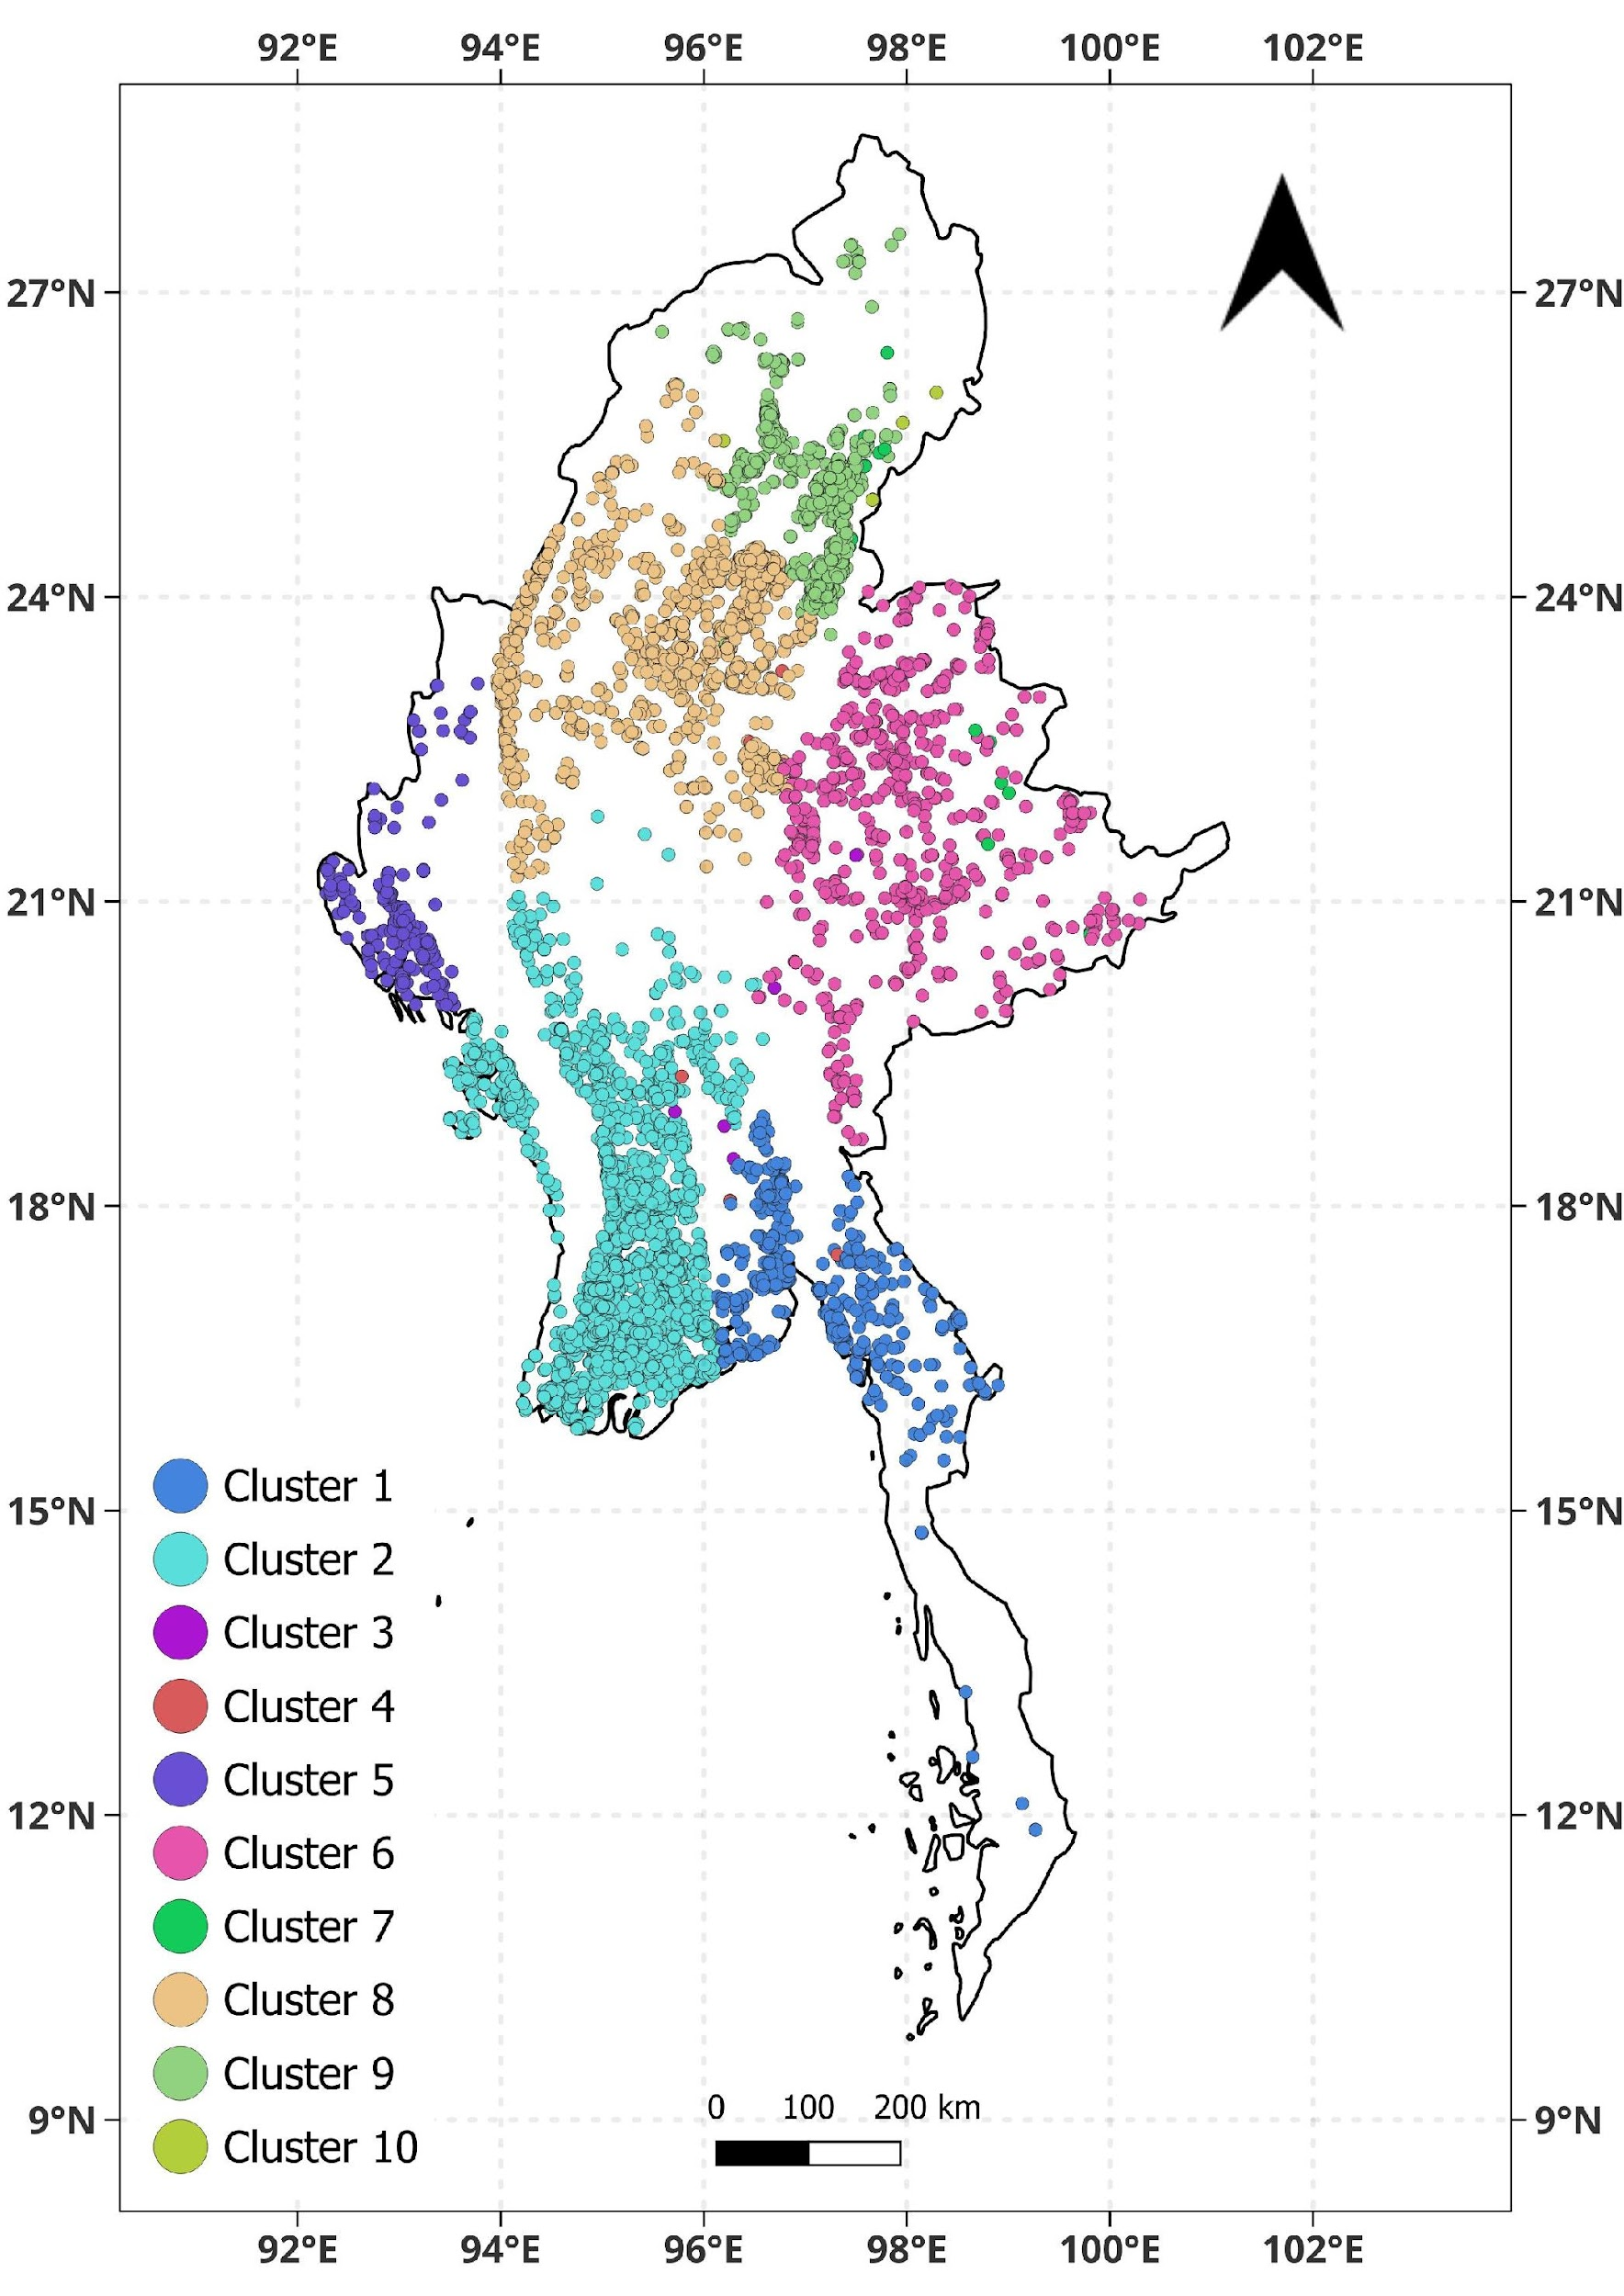
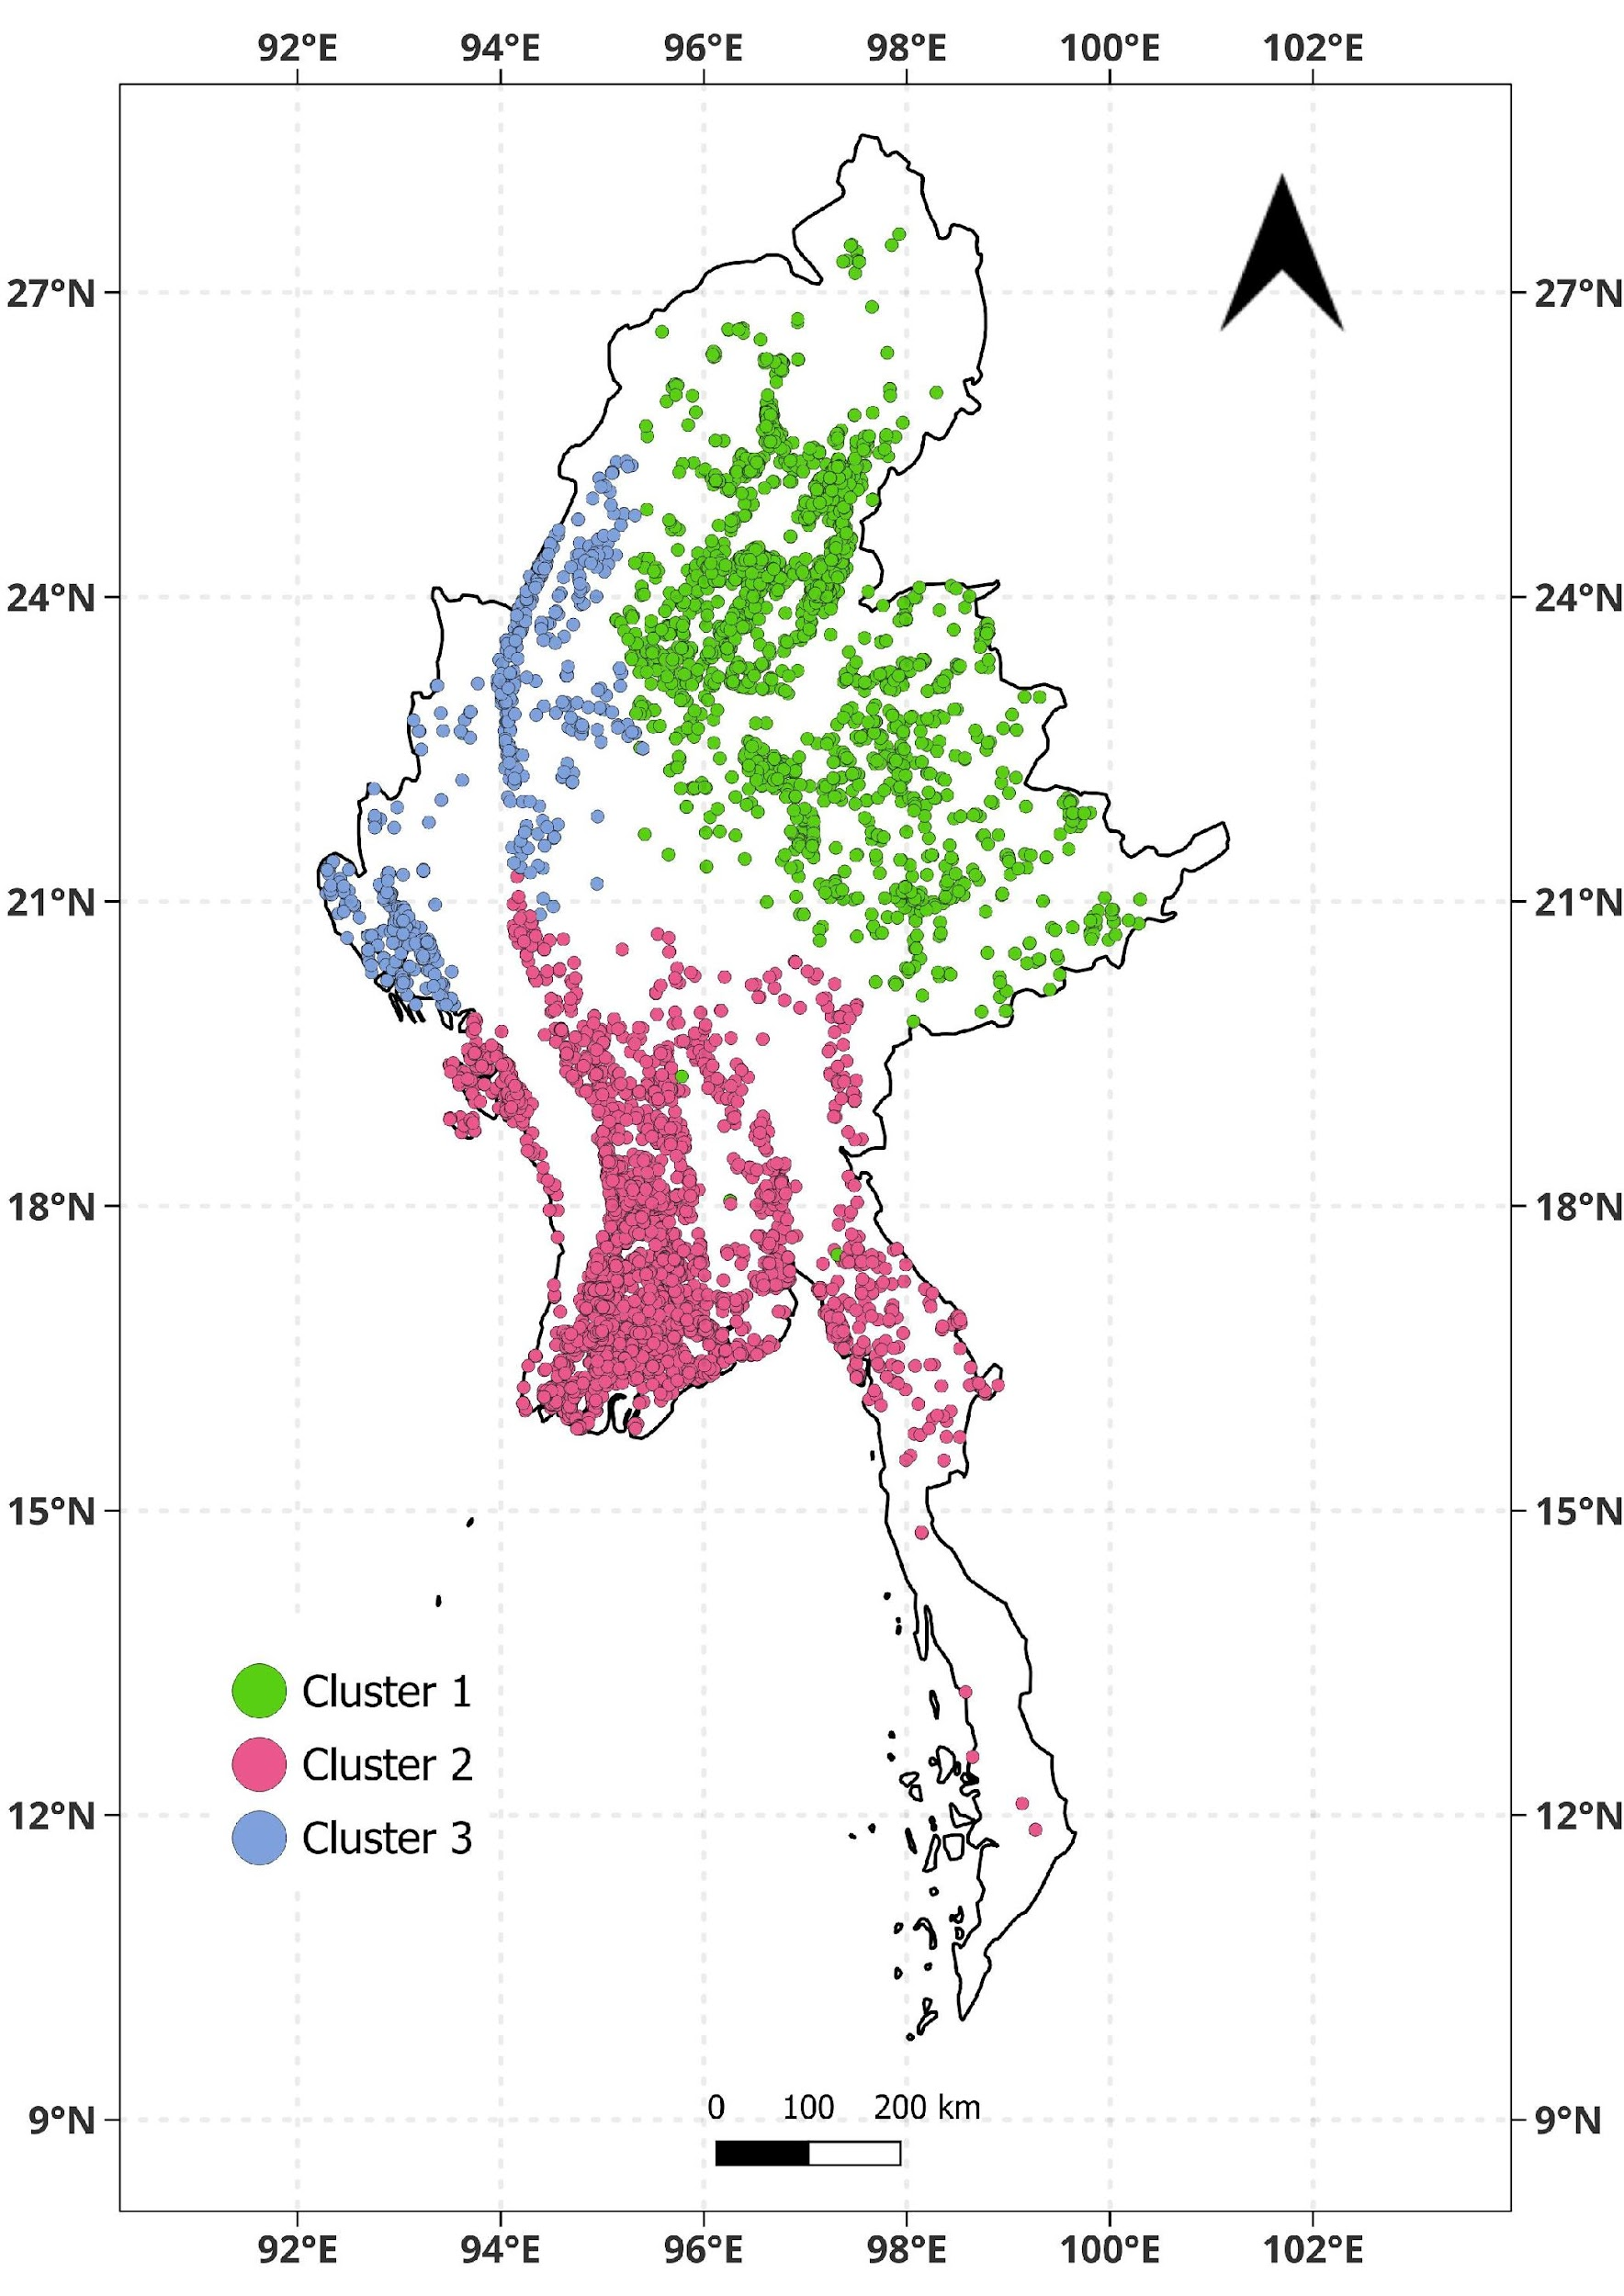
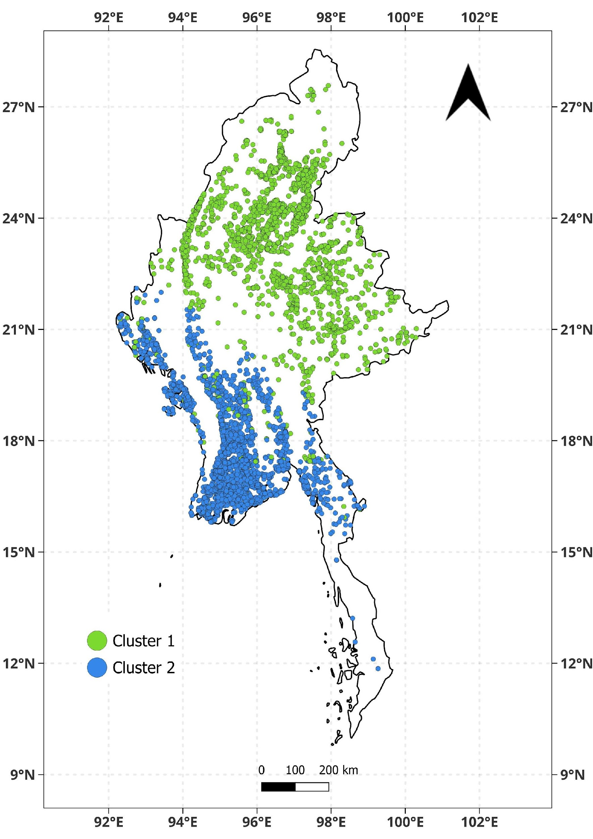
Agricultural Fires
HIERARCHIAL
BIRCH
GMM
(Gaussian Mixture Model)

Slide 5
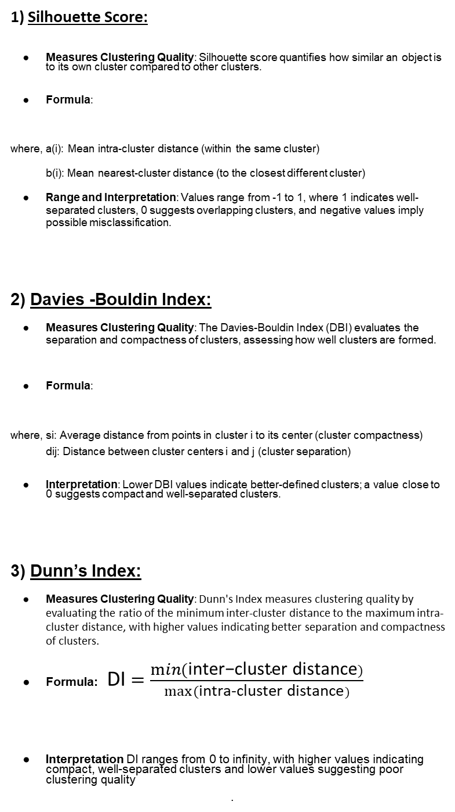
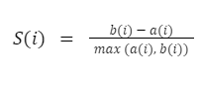
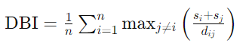
Performance Metrics

Slide 6
Clustering Results
Myanmar Forest Fires - April ‘21
Clustering Algorithm | Number of Clusters | Silhouette Score | Davies - Bouldin Index
KMeans | 6 | 46.92% | 27.2307
DBSCAN | 2 | 29.19% | 42.5491
HiSpatial | 8 | -57.33% | 29.0232
Hierarchical | 6 | 39.04% | 32.2842
BIRCH | 6 | 52% | 118.3592
HDBSCAN | 3 | 17.82% | 6.9184
GMM | 4 | 22.35% | 1.6693
Myanmar Agricultural Fires - April ‘21
Clustering Algorithm | Number of Clusters | Silhouette Score | Davies - Bouldin Index
KMeans | 8 | 40.03% | 279.6517
DBSCAN | 3 | 42.92% | 36.7471
HiSpatial | 5 | -17.33% | 25.6489
Hierarchical | 10 | 38.25% | 13.6215
BIRCH | 3 | 51.97% | 11.9873
HDBSCAN | 4 | 34.88% | 49.9387
GMM | 2 | 50.62% | 2.5213

Slide 7
Results – Forest Fire
Myanmar Forest Fires - April ‘21
Ranking | Clustering Algorithm | Number of Clusters | Silhouette Score | Davies - Bouldin Index
1 | KMeans | 6 | 46.92% | 27.2307
5 | DBSCAN | 2 | 29.19% | 42.5491
7 | HiSpatial | 8 | -57.33% | 29.0232
2 | Hierarchical | 6 | 39.04% | 32.2842
6 | BIRCH | 6 | 52% | 118.3592
4 | HDBSCAN | 3 | 17.82% | 6.9184
3 | GMM | 4 | 22.35% | 1.6693
1. KMeans
Silhouette Score: 46.92% – This score is strong, indicating that the clusters are well-separated and cohesive, meaning KMeans has effectively grouped the data into distinct clusters with minimal overlap.
DBI: 27.2307 – While moderate, the DBI suggests that the clusters are reasonably well-separated but not perfectly so. Given KMeans's relatively high Silhouette Score, this moderate DBI does not significantly diminish its performance.
Algorithm's Role: KMeans is a centroid-based algorithm that assigns each data point to the nearest cluster center. Its simplicity and efficiency allow it to form relatively cohesive clusters with decent separation. While it doesn't necessarily optimize for separation as DBSCAN or HDBSCAN do, it strikes a good balance between cohesion and separation for this dataset, making it the most optimal choice.
2. Hierarchical
Silhouette Score: 39.04% – This score is moderate, suggesting that the clusters are fairly cohesive but not as tightly grouped as in KMeans.
DBI: 32.2842 – This moderate DBI score shows reasonable separation between clusters, but it indicates there could be some overlap or blending between clusters.
Algorithm's Role: Hierarchical clustering builds a tree of clusters, which allows it to model clusters at various levels of granularity. This flexibility can help reveal natural groupings within the data. It produces fairly cohesive clusters, but sometimes the separation isn't as clean, hence the moderate DBI. It is a good option for hierarchical relationships or when the number of clusters is not pre-determined, but here its moderate performance places it in the second spot.

Slide 8
3. GMM (Gaussian Mixture Model)
Silhouette Score: 22.35% – This relatively low score indicates that while the clusters may be mathematically tight, they are not cohesively well-formed or easy to interpret visually.
DBI: 1.6693 – A very low DBI indicates that the clusters are tightly packed and well-separated in terms of distance, suggesting GMM has done a good job of finding tight, distinct clusters.
Algorithm's Role: GMM is a probabilistic model that assumes that the data points are generated from a mixture of several Gaussian distributions. While it can create very tight clusters (as indicated by the low DBI), the poor cohesion (low Silhouette Score) suggests that GMM may have struggled with assigning points correctly to these tight clusters, leading to less meaningful groupings. It’s effective at finding well-separated clusters, but the cluster assignments can be uncertain or inconsistent.
4. HDBSCAN
Silhouette Score: 17.82% – A very low Silhouette Score indicates that the clusters are poorly cohesive, meaning the algorithm has created clusters that do not fit well together.
DBI: 6.9184 – However, the low DBI suggests that HDBSCAN has done a good job in terms of separation, creating well-distinguished clusters.
Algorithm's Role: HDBSCAN is a density-based algorithm that groups points based on their density, which makes it effective at handling data with irregular or varying densities. While it excels in separation, the low cohesion indicates that the algorithm might have formed clusters that do not have strong internal consistency, which leads to a less cohesive overall result.
5. DBSCAN
Silhouette Score: 29.19% – A moderate Silhouette Score, showing that the clusters are not particularly well-formed, but not as poor as HDBSCAN.
DBI: 42.5491 – A high DBI value suggests that the clusters created by DBSCAN are not well-separated, meaning there is substantial overlap between clusters.
Algorithm's Role: DBSCAN is another density-based algorithm, like HDBSCAN, that is well-suited to data with noise and varying cluster shapes. However, it struggles with forming well-separated clusters in this case, as indicated by the high DBI. While DBSCAN is robust to noise and outliers, it doesn’t always create distinct, well-separated clusters unless the parameters are tuned very carefully.

Slide 9
6. BIRCH
Silhouette Score: 52% – This is the highest Silhouette Score, indicating very good cohesion within the clusters, meaning the points within each cluster are very similar to each other.
DBI: 118.3592 – However, BIRCH’s very high DBI indicates that the clusters are poorly separated from each other, meaning that despite good internal cohesion, there is significant overlap between clusters.
Algorithm's Role: BIRCH (Balanced Iterative Reducing and Clustering using Hierarchies) is an efficient clustering algorithm that uses a hierarchical approach combined with a clustering feature tree to form compact clusters. While it shows very tight clusters internally (good cohesion), its weak cluster separation (very high DBI) limits its effectiveness for this dataset. This makes BIRCH less desirable than other algorithms like KMeans, despite the strong cohesion.
7. HiSpatial
Silhouette Score: -57.33% – This is the worst Silhouette Score, indicating very poor cohesion. The clusters are not well-defined and likely to overlap significantly.
DBI: 29.0232 – Moderate DBI value suggests there is some level of separation, but not enough to offset the very poor cohesion.
Algorithm's Role: HiSpatial, designed for spatial clustering, suffers from a combination of very poor cohesion and only moderate separation. This suggests that the algorithm struggles to form meaningful, well-separated groups, resulting in poor clustering performance. This makes it the worst-performing algorithm in this ranking.
Conclusion:
KMeans is ranked the best because it strikes a good balance between Silhouette Score (cohesion) and DBI (separation). It manages to create well-separated, cohesive clusters overall.
Hierarchical follows due to its ability to provide moderate results for both cohesion and separation.
GMM is strong in separation (low DBI) but weak in cohesion (low Silhouette), making it less ideal for this task.
HDBSCAN and DBSCAN perform well in terms of separation but have poor cohesion, making them less effective compared to KMeans and Hierarchical.
BIRCH has good internal cohesion but extremely poor cluster separation, placing it low in the ranking.
HiSpatial performs the worst due to very poor cohesion, even though it shows moderate separation.

Slide 10
Results – Agricultural Fire
Myanmar Forest Fires - April ‘21
Ranking | Clustering Algorithm | Number of Clusters | Silhouette Score | Davies - Bouldin Index
6 | KMeans | 8 | 40.03% | 279.6517
3 | DBSCAN | 3 | 42.92% | 36.7471
7 | HiSpatial | 5 | -17.33% | 25.6489
4 | Hierarchical | 10 | 38.25% | 13.6215
2 | BIRCH | 3 | 51.97% | 11.9873
5 | HDBSCAN | 4 | 34.88% | 49.9387
1 | GMM | 2 | 50.62% | 2.5213
1. GMM (Gaussian Mixture Model)
Silhouette Score: 50.62% – This is a relatively high score, indicating good cohesion within clusters. The clusters are fairly well-separated and cohesive.
DBI: 2.5213 – Very low DBI suggests that the clusters are well-separated and distinct from each other.
Algorithm's Role: GMM assumes that the data is generated from a mixture of Gaussian distributions. It provides probabilistic assignments to clusters, allowing it to capture complex cluster shapes and tight separation. The high Silhouette Score and low DBI suggest that GMM did a good job of finding well-separated, cohesive clusters in this dataset, making it the best-performing algorithm here.
2. BIRCH
Silhouette Score: 51.97% – This is the highest Silhouette Score, indicating excellent internal cohesion within clusters.
DBI: 11.9873 – A moderate DBI value, indicating reasonable separation between clusters, but not as clean as GMM.
Algorithm's Role: BIRCH uses a hierarchical approach combined with clustering feature trees. It produces tight and cohesive clusters, though the separation isn’t as perfect as GMM's. While the moderate DBI suggests some overlap, the high cohesion makes it a strong performer, ranking second.

Slide 11
3. DBSCAN
Silhouette Score: 42.92% – A moderate Silhouette Score, meaning the clusters have decent internal cohesion, but they’re not as well-defined as in GMM or BIRCH.
DBI: 36.7471 – A relatively high DBI indicates that the clusters are not as well-separated, with some overlap.
Algorithm's Role: DBSCAN is a density-based algorithm that is robust to noise and can find clusters of arbitrary shapes. However, it struggles with forming well-separated clusters in this dataset, as indicated by the high DBI. The moderate cohesion makes it a decent choice, but it doesn’t perform as well in separation, putting it in third place.
4. Hierarchical
Silhouette Score: 38.25% – A moderate Silhouette Score, showing that the clusters are somewhat cohesive but not as well-defined as in DBSCAN or GMM.
DBI: 13.6215 – A lower DBI suggests relatively better separation compared to DBSCAN and HiSpatial, but not as good as GMM or BIRCH.
Algorithm's Role: Hierarchical clustering is good at producing a hierarchy of clusters and allows flexibility in the number of clusters. The moderate cohesion and good separation indicate that the algorithm has made decent cluster groupings, but it doesn’t perform as well as GMM and BIRCH in terms of cohesion and overall quality.
5. HDBSCAN
Silhouette Score: 34.88% – This is a relatively low Silhouette Score, indicating that the cohesion of the clusters is not very strong.
DBI: 49.9387 – The high DBI indicates that the clusters formed by HDBSCAN are poorly separated, with significant overlap between them.
Algorithm's Role: HDBSCAN is a density-based algorithm, but it struggles with clustering quality in this case, as evidenced by the low Silhouette Score and high DBI. It has trouble with both cohesion and separation, placing it in the middle of the ranking.
6. KMeans
Silhouette Score: 40.03% – A moderate Silhouette Score, indicating decent cohesion between the clusters.
DBI: 279.6517 – Very high DBI indicates that the clusters are poorly separated, suggesting substantial overlap.
Algorithm's Role: KMeans is a centroid-based method that works well when clusters are spherical and evenly distributed, but it struggles with complex, unevenly distributed data. The very high DBI here suggests poor separation, and the moderate Silhouette Score shows that while the clusters are cohesive, they are not well-separated, which limits its effectiveness for this dataset.

Slide 12
7. HiSpatial
Silhouette Score: -17.33% – This is a very low Silhouette Score, indicating poor cohesion and overlap within clusters.
DBI: 25.6489 – Moderate DBI suggesting some separation, but not enough to overcome the extremely poor cohesion.
Algorithm's Role: HiSpatial, designed for spatial clustering, performed very poorly on this dataset. Its inability to form cohesive clusters (as indicated by the extremely low Silhouette Score) makes it the least effective in this ranking, despite some moderate separation between clusters as indicated by the DBI.
Conclusion:
GMM is ranked first because it balances both Silhouette Score (cohesion) and DBI (separation), forming well-separated, cohesive clusters.
BIRCH ranks second due to its excellent cohesion and moderate separation.
DBSCAN is third due to its moderate cohesion and poor separation, though still performing decently compared to others.
Hierarchical is ranked fourth because it shows reasonable separation but only moderate cohesion.
HDBSCAN performs poorly in terms of both cohesion and separation, which places it fifth.
KMeans comes sixth due to poor separation and moderate cohesion, making it less effective here.
HiSpatial is ranked last because of very poor cohesion, despite some reasonable separation between clusters.

